Slide 1

9. Data structures
Subtitle
Notes:
NOTE:
To change the image on this slide, select the picture and delete it. Then click the Pictures icon in the placeholder to insert your own image.

Slide 2
Content
9.1 Arrays
9.2 Records
9.3 Linked List
9.4 Introduction: Stack, Queue, Tree, graph

Slide 3
Objectives
After studying this chapter, the student should be able to:
Define a data structure.
Define an array as a data structure and how it is used to store a list of data items.
Distinguish between the name of an array and the names of the elements in an array.
Describe operations defined for an array.
Define a record as a data structure and how it is used to store attributes belonging to a single data element.
Distinguish between the name of a record and the names of its fields.
Define a linked list as a data structure and how it is implemented using pointers.
Describe operations defined for a linked list.
Compare and contrast arrays, records, and linked lists.
Define the applications of arrays, records, and linked lists.

Slide 4
1 - Arrays

Slide 5
1. Introduction
An array is a sequenced collection of elements, of the same data type. We can refer to the elements in the array as the first element, the second element, and so forth until we get to the last element.
If we were to put our 100 scores into an array, we could designate the elements as scores[1], scores[2], and so on.
The index indicates the ordinal number of the element, counting from the beginning of the array. The elements of the array are individually addressed through their subscripts (Figure 11.3).
The array as a whole has a name, scores, but each score can be accessed individually using its subscript.
Figure 9.1 Array with indexs
Notes:
subscript

Slide 6
2. Loops
We can use loops to read and write the elements in an array. We can also use loops to process elements. Now it does not matter if there are 100, 1000, or 10,000 elements to be processed—loops make it easy to handle them all.
We can use an integer variable to control the loop, and remain in the loop as long as the value of this variable is less than the total number of elements in the array (Figure 11.4).
Figure 9.2 Processing a array
Notes:
Elenment : phần tử

Slide 7
3. Multi-dimensional arrays
The arrays discussed so far are known as one-dimensional arrays because the data is organized linearly in only one direction.
Many applications require that data be stored in more than one dimension. Figure 11.5 shows a table, which is commonly called a two-dimensional array.
Figure 9.3 A two-dimensional array

Slide 8
4. Memory layout
The indexes in a one-dimensional array directly define the relative positions of the element in actual memory. A two-dimensional array, however, represents rows and columns. How each element is stored in memory depends on the computer.
Most computers use row-major storage, in which an entire row of an array is stored in memory before the next row. However, a computer may store the array using column-major storage, in which the entire column is stored before the next column.
Figure 9.4 Memory layout of arrays

Slide 9
5. Operations on array
Although we can apply conventional operations defined for each element of an array there are some operations that we can define on an array as a data structure.
The common operations on arrays as structures are searching, insertion, deletion, retrieval, and traversal
Figure 9.5 Insert a value to array

Slide 10
2- Records

Slide 11
1. Introduction
A record is a collection of related elements, possibly of different types, having a single name. Each element in a record is called a field.
A field is the smallest element of named data that has meaning. A field has a type, and exists in memory. Fields can be assigned values, which in turn can be accessed for selection or manipulation. A field differs from a variable primarily in that it is part of a record.
Figure 9.6 Records

Slide 12
2. Record name versus field name
Just like in an array, we have two types of identifier in a record: the name of the record and the name of each individual field inside the record. The name of the record is the name of the whole structure, while the name of each field allows us to refer to that field.
For example, in the student record of Figure 11.7, the name of the record is student, the name of the fields are student.id, student.name, and student.grade
Figure 9.7 Insert a value to array

Slide 13
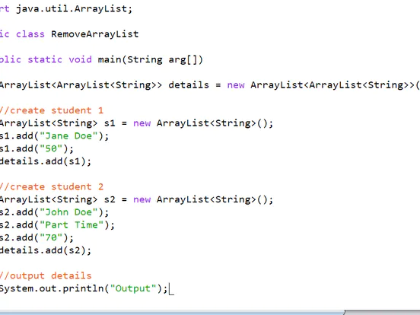
3. Comparison of records and arrays
We can conceptually compare an array with a record. This helps us to understand when we should use an array and when a record. An array defines a combination of elements, while a record defines the identifiable parts of an element.
For example, an array can define a class of students (40 students), but a record defines different attributes of a student, such as id, name, or grade.
Figure 9.8 Insert a record (name, status, grade) to array of students in Java

Slide 14
4. Array of records
If we need to define a combination of element and at the same time some attributes of each element, we can use an array of records. For example, in a class of 30 students, we can have an array of 30 records, each record representing a student. Figure 11.8 shows an array of 30 student records called students.
Figure 9.9 Insert a value to array

Slide 15
3 - Linked List

Slide 16
1. Introduction
A linked list is a collection of data in which each element contains the location of the next element—that is, each element contains two parts: data and link. The data part holds the value information: the data to be processed.
The link is used to chain the data together, and contains a pointer (an address) that identifies the next element in the list. In addition, a pointer variable identifies the first element in the list. The name of the list is the same as the name of this pointer variable.
Figure 9.10 Linked lists
Notes:
Collection of data : tập hợp dữ liệu - That is : nghĩa là
Data to be processed: dữ liệu được xử lý.
Chain : nối identifies : xác định
Null pointer : con trỏ ko trỏ tới vùng nhớ nào
Node : đại diện cho 1 phần tử trong linked list và nó chứa dữ liệu và 1 con trỏ trỏ đén phần tử tiếp theo trong danh sách

Slide 17
2. Arrays versus linked lists
Both an array and a linked list are representations of a list of items in memory. The only difference is the way in which the items are linked together. In an array of records, the linking tool is the index.
The element scores[3] is linked to the element scores[4] because the integer 4 comes after the integer 3. In a linked list, the linking tool is the link that points to the next element—the pointer or the address of the next element.
Figure 11.11 compares the two representations for a list of five integers.
Figure 9.11 Array versus linked list
Notes:
Mảng so với danh sách liên kết
Representations : các biểu diễn , list of items in memory : các mục trong bộ nhớ
Items : các mục. Array of records: Trong một mảng ghi chép
. Phần tử scores[3] được liên kết với phần tử scores[4] vì số nguyên 4 đứng sau số nguyên 3
Point to : trỏ đến
. Hình 11.11 so sánh hai biểu diễn cho một danh sách gồm năm số nguyên.

Slide 18
3. Linked list names versus nodes names
As for arrays and records, we need to distinguish between the name of the linked list and the names of the nodes, the elements of a linked list. A linked list must have a name.
Figure 9.12 The name of a linked list versus the names of nodes
Notes:
Tên danh sách liên kết so với
Giống như mảng và ghi chép, chúng ta cần phải phân biệt giữa tên của danh sách liên kết và tên của các nút (nodes), các phần tử của danh sách liên kết. Một danh sách liên kết phải có một tên.tên nút (node)

Slide 19
4. Operations on linked lists (searching)
The search algorithm for a linked list can only be sequential because the nodes in a linked list have no specific names (unlike the elements in an array) that can be found using a binary search.
However, since nodes in a linked list have no names, we use two pointers, pre (for previous) and cur (for current).
Algorithm 9.1 Searching a linked list

Slide 20
5. Operations on linked lists (inserting)
Before insertion into a linked list need searching algorithm.
If the flag returned from the searching algorithm is false, will allow insertion,
otherwise abort the insertion algorithm Four cases can arise:
Inserting into an empty list.
Insertion at the beginning of the list.
Insertion at the end of the list.
Insertion in the middle of the list.
Algorithm 9.2 Inserting to a linked list

Slide 21
4- Introduction: Stack, Queue, Tree, graph

Slide 22
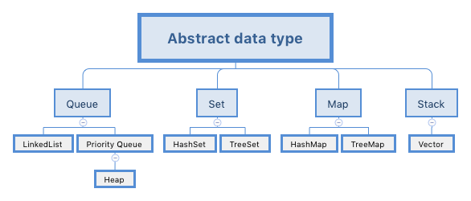
1. BACKGROUND
Problem solving with a computer means processing data. To process data, we need to define the data type and the operation to be performed on the data.
For example, to find the sum of a list of numbers, we should select the type for the number (integer or real) and define the operation (addition). The definition of the data type and the definition of the operation to be applied to the data is part of the idea behind an abstract data type
Figure 9.13 Structure of abstract data type

Slide 23
2. STACKS
A stack is a restricted linear list in which all additions and deletions are made at one end, the top. If we insert a series of data into a stack and then remove it, the order of the data is reversed. Data input as 5, 10, 15, 20, for example, would be removed as 20, 15, 10, and 5.
Figure 9.14 Three representations of stacks

Slide 24
Operations on stacks
Although we can define many operations for a stack, there are four basic operations, stack, push, pop, and empty, which we define in this chapter.
Figure 12.2 Three representations of stacks
Figure 9.15 Three representations of stacks

Slide 25
3. QUEUES
A queue is a linear list in which data can only be inserted at one end, called the rear, and deleted from the other end, called the front. These restrictions ensure that the data are processed through the queue in the order in which it is received. In other words, a queue is a first in, first out (FIFO) structure.
Figure 9.16 Two representations of queues

Slide 26
Operations on queues
The queue operation
The queue operation creates an empty queue. The following shows the format:
Figure 9.17 The enqueue operation

Slide 27
Operations on queues (cont)
The dequeue operation
The dequeue operation deletes the item at the front of the queue. The following shows the format:
Figure 9.18 The dequeue operation

Slide 28
Operations on queues (cont)
The empty operation
The empty operation checks the status of the queue. The following shows the format:

Slide 29
Queue ADT
We define a queue as an ADT as shown below:

Slide 30
Queue implementation
At the ADT level, we use the queue and its four operations (queue, enqueue, dequeue, and empty): at the implementation level, we need to choose a data structure to implement it.
A queue ADT can be implemented using either an array or a linked list
Figure 9.19 Queue implementation

Slide 31
3. TREES
A tree consists of a finite set of elements, called nodes (or vertices), and a finite set of directed lines, called arcs, that connect pairs of the nodes. If the tree is not empty, one of the nodes, called the root, has no incoming arcs.
The other nodes in a tree can be reached from the root by following a unique path, which is a sequence of consecutive arcs. Tree structures are normally drawn upside down with the root at the top
Figure 9.20 Tree representation
Notes:
Nút B , F : Có con <- gọi là nút trong
C ,D,E,G,H,I : Không có con <- gọi là lá

Slide 32
Binary trees
A binary tree is a tree in which no node can have more than two subtrees. In other words, a node can have zero, one, or two subtrees. These subtrees are designated as the left subtree and the right subtree.
Figure 12.22 shows a binary tree with its two subtrees
Figure 9.21 A binary tree
Notes:
No node : không có con
Cây con trái, cây con phải của nút gốc A,

Slide 33
Operations on binary trees
Binary tree traversals
A binary tree traversal requires that each node of the tree be processed once and only once in a predetermined sequence. The two general approaches to the traversal sequence are depth-first and breadth-first traversal
Figure 9.22 Depth-first traversal of a binary tree
Notes:
Operations on binary tree: thao tác trên cây nhị phân
Hoạt động trên cây nhị phân ( hành đôg) :
Traversals ( duyệt, truy cập/viếng thăm ) qua các node ( nút ) trên tree ( cây ) theo thứ tự xác định cho trước
Có nhiều phương pháp duyệt cây để truy cập tất cả các nút trong cây, bao gồm:
Pre-order traversal: duyệt cây theo thứ tự gốc-trái-phải. ( tiền ) Con trái/phải , cha
In-order traversal: duyệt cây theo thứ tự trái-gốc-phải. ( trung )
Post-order traversal: duyệt cây theo thứ tự trái-phải-gốc. ( hậu )

Slide 34
Binary tree applications
Huffman coding is a compression technique that uses binary trees to generate a variable length binary code from a string of symbols.
Expression trees An arithmetic expression can be represented in three different formats: infix, postfix, and prefix. In an infix notation, the operator comes between the two operands. In postfix notation, the operator comes after its two operands, and in prefix notation it comes before the two operands. These formats are shown below for the addition of two operands A and B.
Figure 9.23 Expression tree
Notes:
Huffman coding : kỹ thuật nén dữ liệu ; variable ( a) : biến thiên .
Variable length binary code : mã nhị phân có độ dài biến thiên ; string of symbols : chuoi biểu tượng
Phương pháp Huffman coding được sử dụng rộng rãi trong việc nén dữ liệu, đặc biệt là trong các định dạng hình ảnh, âm thanh và video.
Infix: trung tố , prefix : tiền tố , Postfix: hậu tố
2 ứng dụng : Huffman coding và Expression trees

Slide 35
Binary search trees
A binary search tree (BST) is a binary tree with one extra property: the key value of each node is greater than the key values of all nodes in each left subtree and smaller than the value of all nodes in each right subtree. Figure 12.28 shows the idea
Figure 9.24 Binary search tree (BST)
K
Notes:
Khi Duyệt 1 cây tìm kiếm nhị phân theo phương pháp chung thứ tự -> ta sẽ ra được kết quả là 1 danh sách các phần tử…
Mọi thứ trong tam giác phải > k, mọi thứ trong tam giác trái < K
Vd. Số 15. Đầu tiên, so sánh 15 vs

Slide 36
4. GRAPHS
A graph is an ADT made of a set of nodes, called vertices, and set of lines connecting the vertices, called edges or arcs. Whereas a tree defines a hierarchical structure in which a node can have only one single parent, each node in a graph can have one or more parents.
Graphs may be either directed or undirected. In a directed graph, or digraph, each edge, which connects two vertices, has a direction (shown in the figure by an arrowhead) from one vertex to the other. In an undirected graph, there is no direction. Figure 12.32 shows an example of both a directed graph (a) and an undirected graph (b).
Figure 9.25 Graph

Slide 37
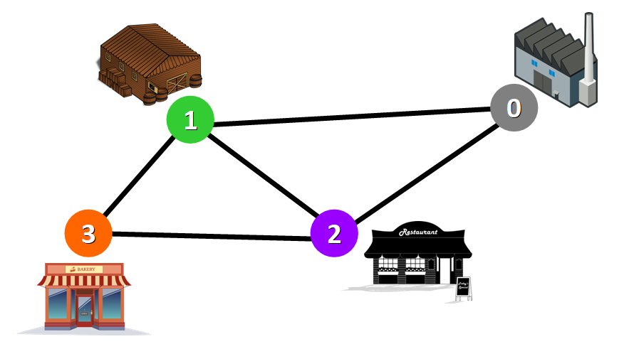
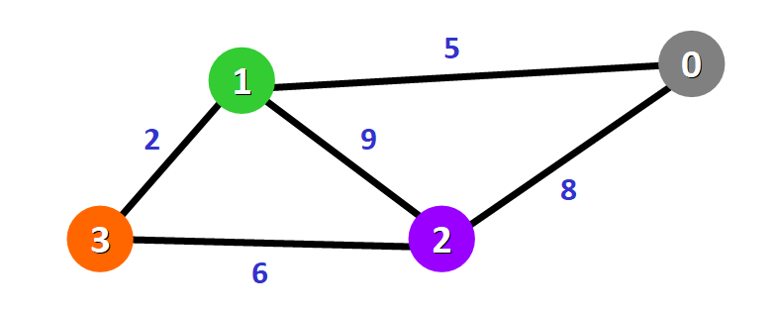
Example
Graphs are directly applicable to real-world scenarios. For example, we could use graphs to model a transportation network where nodes would represent facilities that send or receive products and edges would represent roads or paths that connect them (see below).
Use weighted graphs, in which each edge has a weight that represent the distance between two cities connected by that edge.
Figure 9.26 Network represented with a graph

